Slide 1
Team Hotspotter
Developers
Dylan Williams Quality Assurance
Spencer Smith Customer Proxy
Nathan Reinhardt Scrum Master
Client
Dr. Igor Crk Southern Illinois University Edwardsville Department of Computer Science Edwardsville, IL 62026-1656

Slide 2
About our Project
Overview
Scan Git based repositories to find potential buggy code based off project contributors and file change frequency
Domain and Business
Developers
Tracking bug-fixing commits
Testing code before pulling into project master
Project Managers
Assigning troublesome tasks to more experienced developers
Open Source Contributors
Looking to contribute code to most relevant portions of the codebase

Slide 3
About our Project (Cont.)
Core functionality
Scans repositories finding bug hotspots using dynamic metric
Run from remote server
Provide centralized database to store scan results and repository
Automatic repository syncing
Scan result history
Create visualization of repository with heat map
Filter repository heat map based on author, file, etc.

Slide 4




Project Plan: Management
Defined GIT practices
Collaboration and responsibility
Jira
Agile Planning
Jenkins
Automated quality/tests
Automated deployment

Slide 5
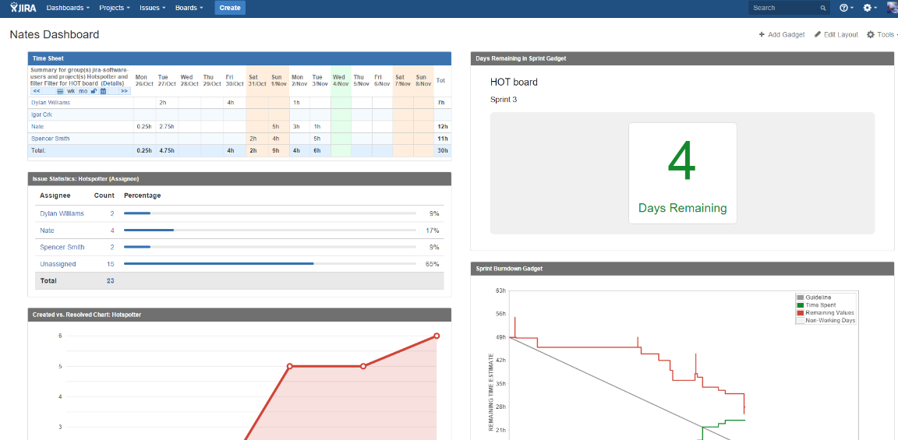
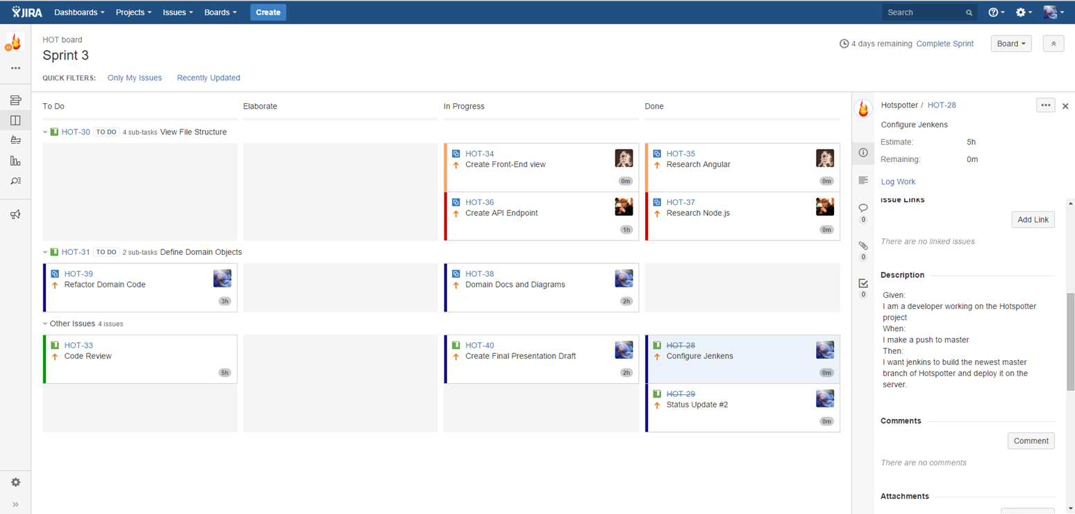
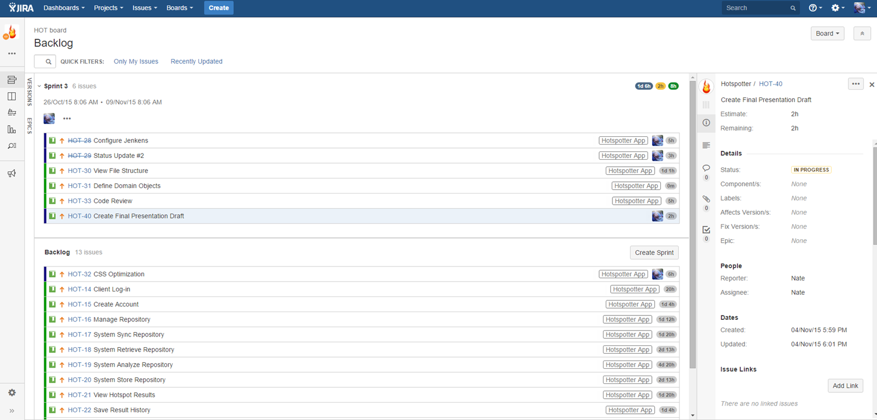
Project Plan: Management (Cont.)

Slide 6
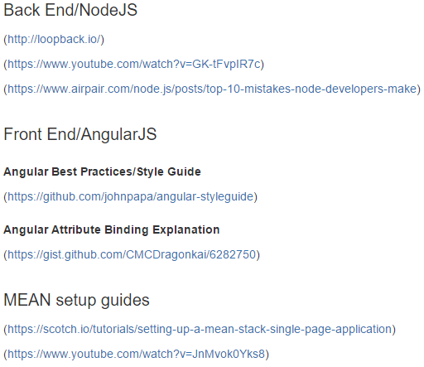
Project plan: Risks
Tech Stack Knowledge
Mitigated by:
Sharing resources and guide in the project README. Every time we found something new individually we made an effort to update the readme for other team members to use.
Agile Methodologies
Mitigated by:
Jira
Jenkins
Defined Git plan

Slide 7
QUALITY ASSURANCE
Git
Well-defined git workflow to maintain consistency
Pull Locally
Branch
Commit Often
Push
Pull Request
Merge to Master
Bitbucket
Pull requests
Full Team Approval
Commenting for clarity and potential errors
Constant feedback

Slide 8
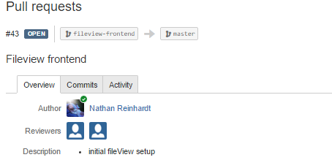
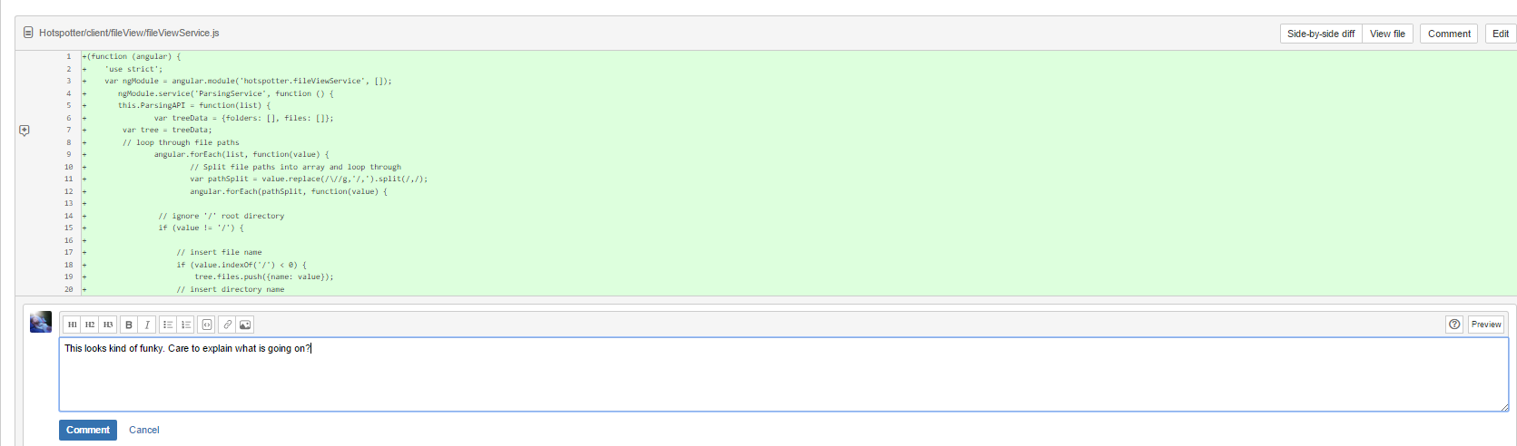
QUALITY ASSURANCE (cont.)

Slide 9
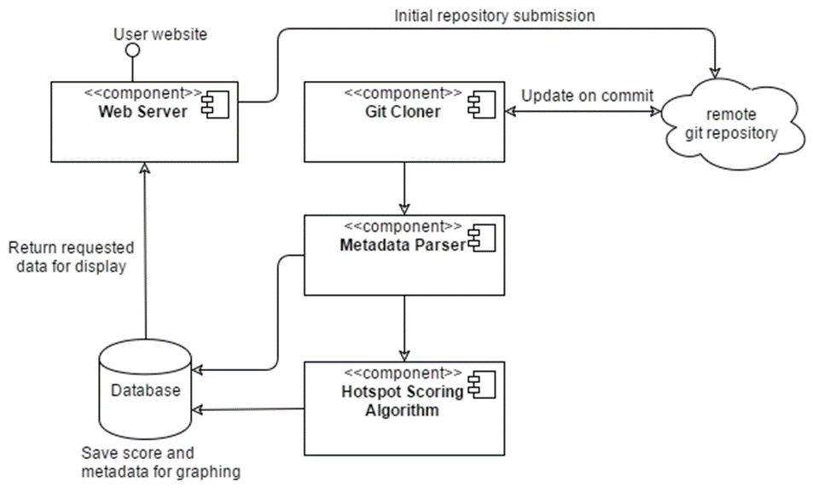




Project Architecture
Client/Server Configuration
MEAN Tech Stack
MongoDB- Database
Express -Middleware
AngularJS – Client Side
NodeJS- Server Side

Slide 10
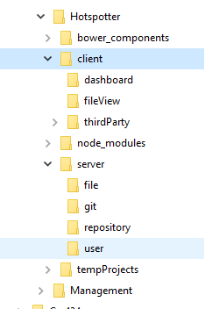
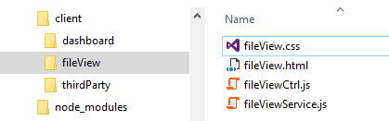
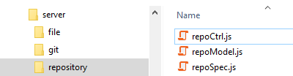
Efforts
Feature driven MVC
Distributed controller

Slide 11
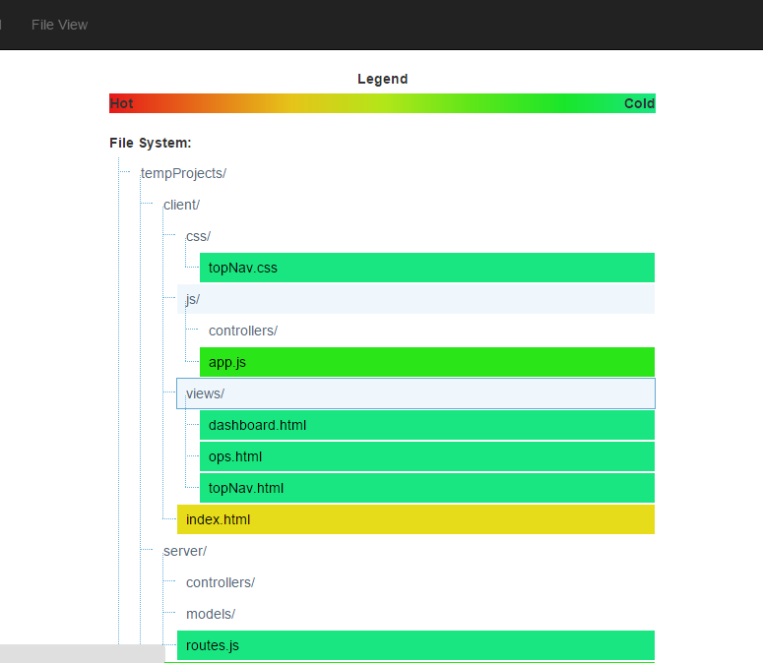
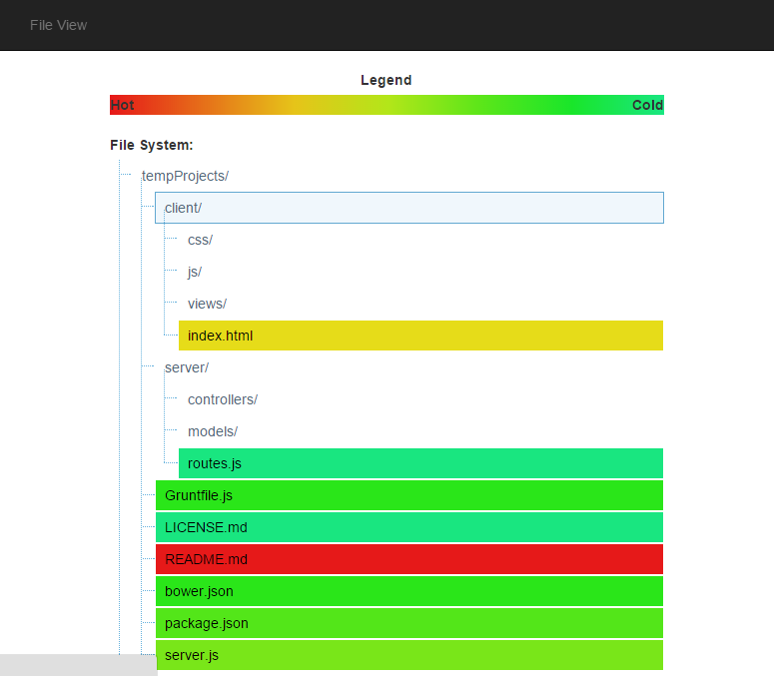
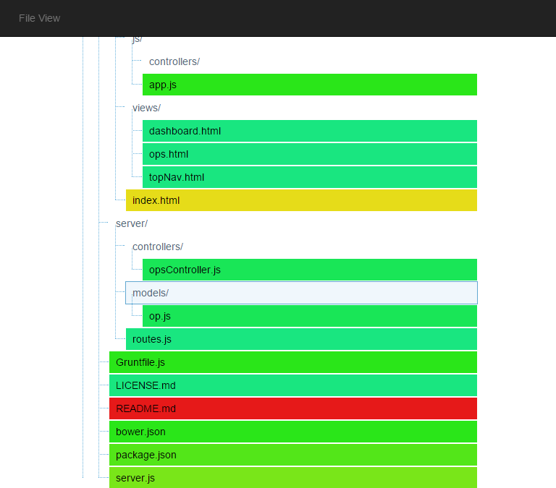
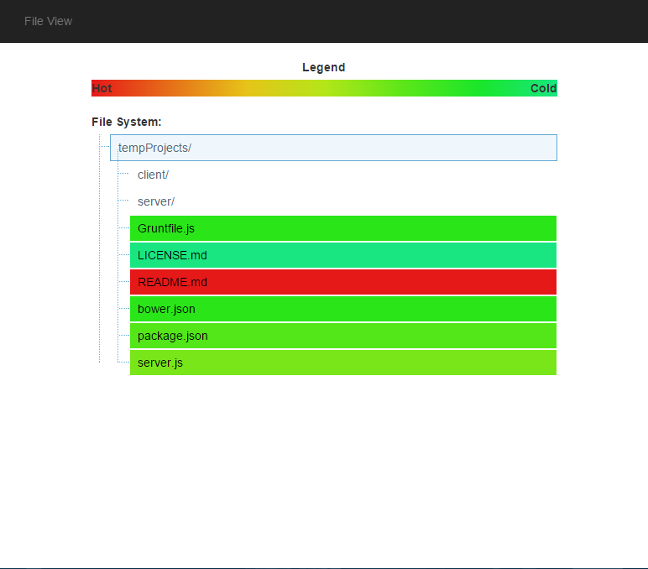
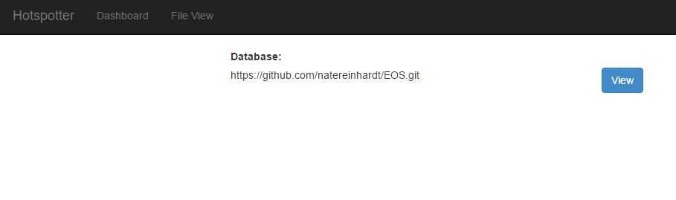
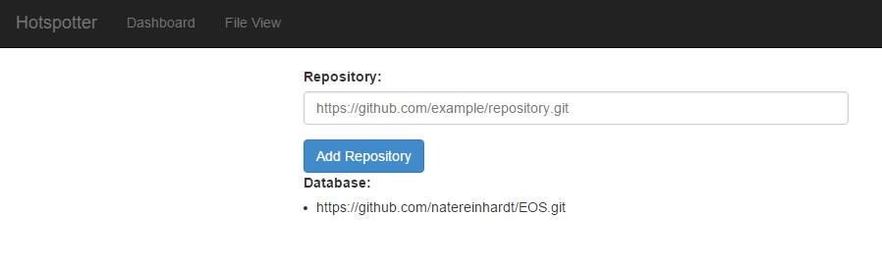
Artifact
Prototype

Slide 12
Cs425 exit strategy
Met:
Working prototype with base/minimal functionality of visualization
Familiarization of tech stack of all members of the team
Was Not Met:
Testing

Slide 13
Post-Mortem
Good:
Processes set-in and adopted by every team member.
Great base project to work off of for next semester.
Team learned a completely new tech stack.
Bad:
Time planning was slow at first.
Didn’t get to writing tests for the prototype

Slide 14
Cs 499
Next Semester
Our goal going forward is to use all the processes we set this semester and become a high performing agile team.
We want to take the existing prototype and start to add scoring algorithms and UI changes
Implement a dynamic testing suite for existing code.
Develop with Angular and Node “best practices” in mind.

Slide 15
Questions?

